Slide 1
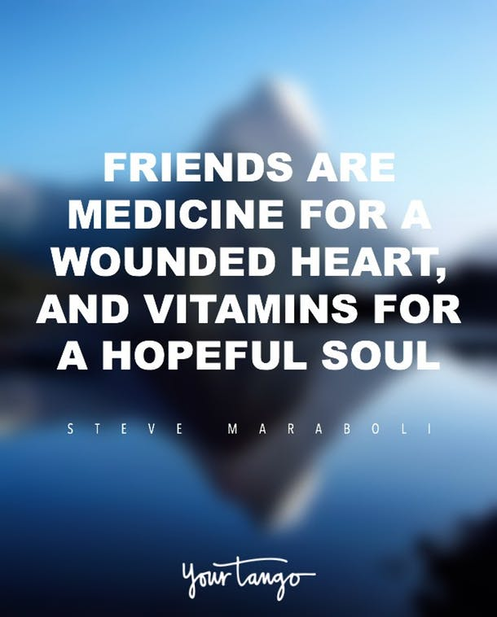
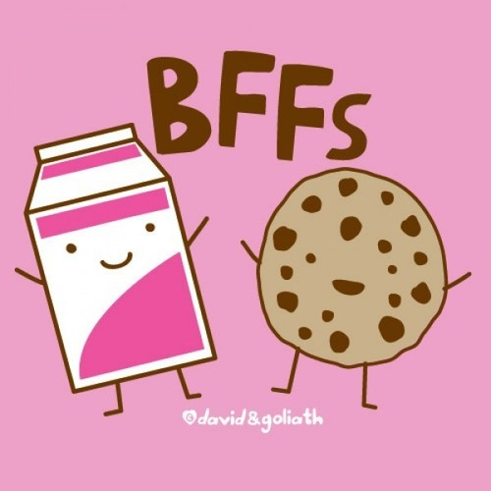
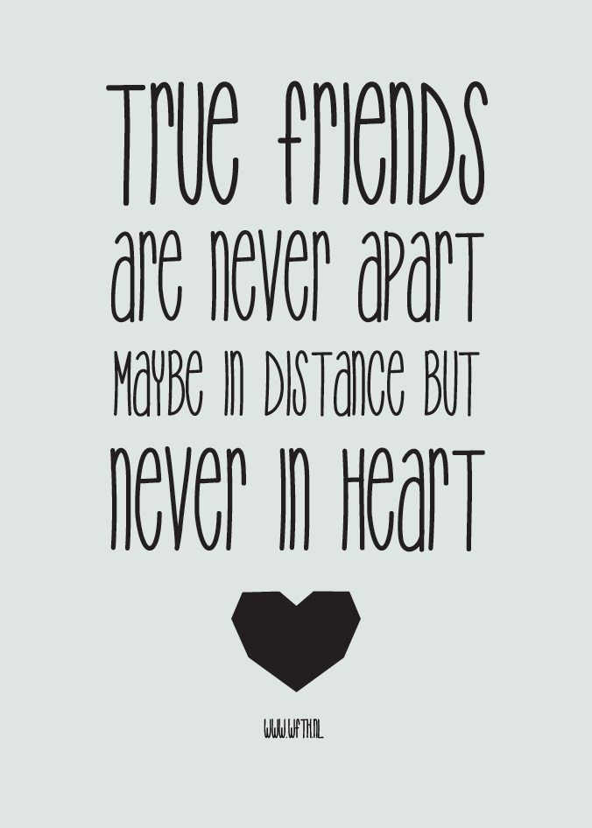
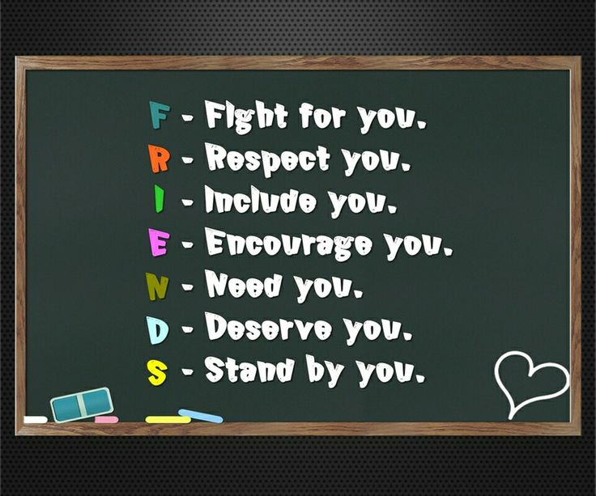
FRIENDSHIP

Slide 2
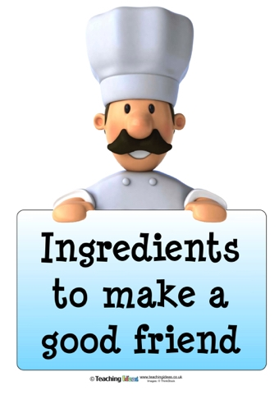

Slide 3
Kindness
Hopefullness
Forgiveness
Can you think of some???

Slide 4
We made some scripts which show how a good friend should act and an unkind person will act !!!!
:)

Slide 5
Notes:
Please listen and enjoy

Slide 7
We are going to blindfold someone so if you would like to please put your hand up
You will be blindfolded and your friend will guide you to the cone there will be some obstacles trust your friend!!

Slide 8
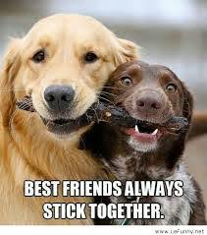

Slide 9
Thank you for listening :)

Slide 10
BY ETHOS COMMITTIEE

